Slide 1

PREDICT THE STOCK PRICES WITH DEEP LEARNING
Presented by TANGARI MAURO

Slide 2




PROJECT TASK
Stock price prediction is a complex task in finance and machine learning, involving the forecasting of future stock prices based on historical data and relevant features like trading volume, technical indicators, and market sentiment.
This project focuses on utilizing two prominent approaches: Transformers, including BERT models, and Bidirectional Long Short-Term Memory (Bi-LSTM) models.
The project encompasses the design, implementation, and evaluation of deep learning models tailored for stock price prediction. It begins with individual exploration of Transformer and BiLSTM architectures and culminates in the development of a hybrid model combining both. The dataset comprises historical stock prices of four key companies—Google, Microsoft, Amazon, and Apple—listed on the NasdaqGS market. The project's objective is to predict the next-day, 2-days-after, and next-week stock prices for Open, High, Low, and Close values for each of these companies.

Slide 3
UTILS
GOOGLE COLAB
PYTHON
TENSORFLOW
KERAS

Slide 4
CONTENTS
01
02
03
04
RECALLS
DATASETS &
DATA-PRE PROCESS
DEEP LEARNING MODELS
MODEL EVALUATION & RESULTS

Slide 5


01
DATASETS

Slide 6


STRUCTURE OF DATASET
[1005 rows x 7 columns]
Date | Close | Open | High | Low | Adj Close | Volume
2019-08-21 | 53.23 | 51.16177 | 52.69 | 51.4918 | 51.48 | 61.883
2019-08-22 | 53.19416 | 53.6662 | 52.157 | 52.714 | 52.25 | 60.86
2019-08-23 | … | … | … | … | … | …
2019-08-24 | … | … | … | … | … | …
… | … | … | … | … | … | …
2023-08-17 | 50.84 | 51.81 | 52.87 | 51.83 | 50.812 | 62.932

Slide 7
DATASETS INFO
The datasets used were from Yahoo Finance and concerned the companies: Amazon, Apple, Microsoft and Google and all of these have the same date range from 21-August 2019 to 18-08-2023, so 4 years of day-by-day values.

Slide 8







DATA PRE PROCESS
STRING TO DATETIME
DROPNA
convert a date string into a datetime object.
Removal of missing or null data
NORMALIZZAZIONE
INPUT E TARGET
Normalizzazione dei dati con la tecnica min-Max.
Data normalisation using the min-max technique.
DIVISIONE DEI DATI
INPUT 3D
The data from X and Y are divided into 80% Training, 20% Validation and 20% Test
Addition of a fictitious time dimension for both features and targets.

Slide 9
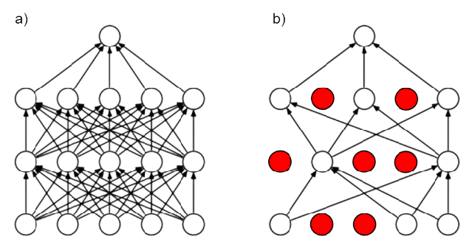
02
RECALLS

Slide 10

DROPOUT
Dropout is an efficient way of averaging many large neural networks.
This technique works like this:
During Training a percentage, at random, of units in one or more layers of the network is temporarily dropped out.
Then during the training iteration some connections are disregarded.
It is not applied during the Test process.
Usually the dropout value is 0.2 or 0.5 but can also be adjusted.
This technique can be implemented with the dropout layer that randomly introduces binary masks (0, 1) into the units during training:1 Attivo
0 Not Active
With the Dropout we have:
Greater robustness
Less overfitting
Less dependence on specific connections

Slide 11
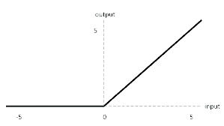

ACTIVATION FUNCTIONS
Activation functions are key components in artificial neural networks and are used to introduce non-linearity into models. These functions determine whether an artificial neuron should be activated (firing) or not based on the weighted sum of its inputs.
Activation functions play a key role in neural networks for several reasons:
Introduction of Non-Linearity
Hierarchical Feature Learning
Information Management
The activation function used in this project is the ReLu (Rectified Linear Unit).
It is a non-linear activation function that returns the input itself if it is positive and zero otherwise.

Slide 12
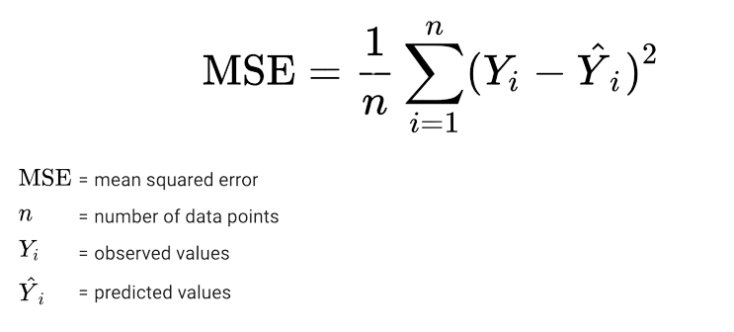
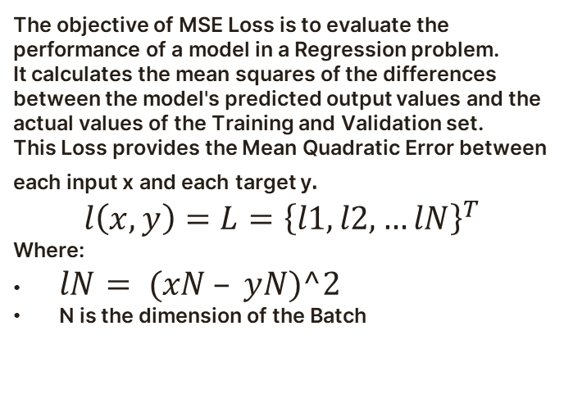
MSE LOSS
The objective of MSE Loss is to evaluate the performance of a model in a Regression problem.
It calculates the mean squares of the differences between the model's predicted output values and the actual values of the Training and Validation set.
This Loss provides the Mean Quadratic Error between each input x and each target y$.$
$$l\left(x,y\right)=L={\left\{l1, l2, …lN\right\}}^{T}$$
Where:
$lN= (xN – yN)^2$
N is the dimension of the Batch

Slide 13
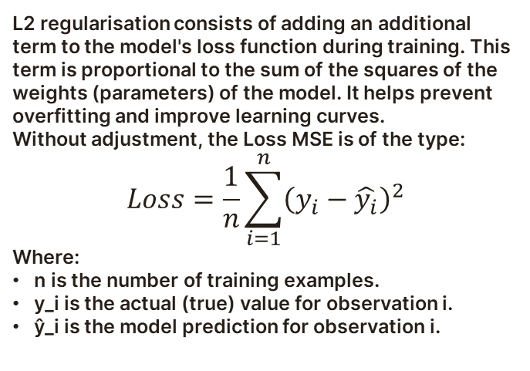
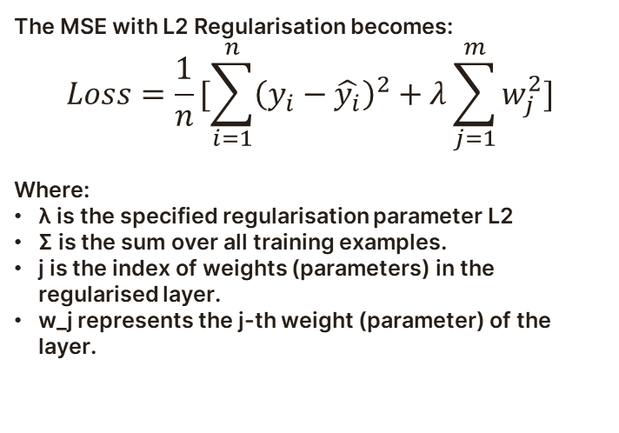
L2 REGULARIZATION
L2 regularisation consists of adding an additional term to the model's loss function during training. This term is proportional to the sum of the squares of the weights (parameters) of the model. It helps prevent overfitting and improve learning curves.
Without adjustment, the Loss MSE is of the type:
$$Loss=\frac{1}{n}\sum_{i=1}^{n}{{\left(y_{i}−\hat{y_{i}}\right)}^{2}}$$
Where:
n is the number of training examples.
y_i is the actual (true) value for observation i.
ŷ_i is the model prediction for observation i.
The MSE with L2 Regularisation becomes:
$$Loss=\frac{1}{n}[\sum_{i=1}^{n}{{\left(y_{i}−\hat{y_{i}}\right)}^{2}}+λ\sum_{j=1}^{m}{w_{j}^{2}}]$$
Where:
λ is the specified regularisation parameter L2
Σ is the sum over all training examples.
j is the index of weights (parameters) in the regularised layer.
w_j represents the j-th weight (parameter) of the layer.

Slide 14

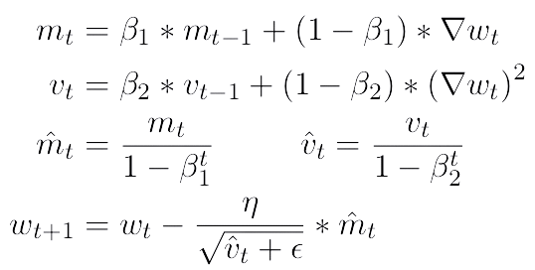
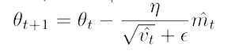
OPTIMIZER: ADAM
Adam is a method that calculates the adaptive learning rate for each parameter and stores the exponential decay average of past quadratic gradients for each time step t like the Adadelta and RMSprop optimisers, but also stores one similar to Momentum.
So we have:
Mean of the gradients mt
Uncentred variance of the gradients vt
Adam's parameter update rule is:

Slide 15


03
MODELS

Slide 16

MODELS
1
2
3
4
SIMPLY TRANSFORMER
BI-LSTM
HYBRID
(MIXTURE MODEL)
HYBRID
(with WEIGHTED ATTENTION)

Slide 17
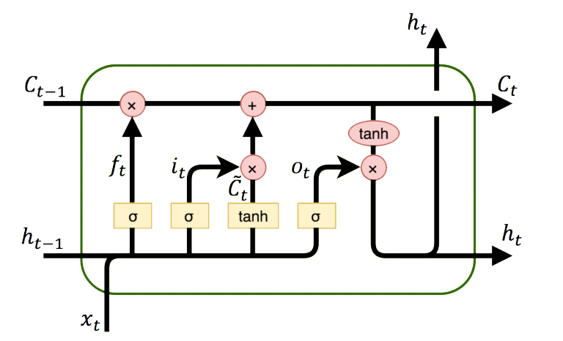
LSTM
An LSTM network is an advanced recurrent neural network (RNN) that is designed to
solve the problem of long-term dependencies
handle problems where the temporal sequence of data is important, in fact they have an internal memory that can store long-term information and allow information to flow from one temporal state to another.
There are 4 gates that control the flow of information in memory cells:
FORGET
STORE
UPDATE
OUTPUT

Slide 18

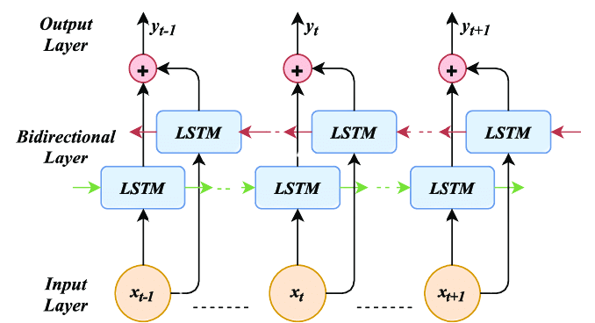
BI-LSTM
A Bi-LSTM network functions similarly to a normal LSTM, but has some key differences:
Two-way
Chained Output
Greater Capability of Capturing Time Dependencies

Slide 19
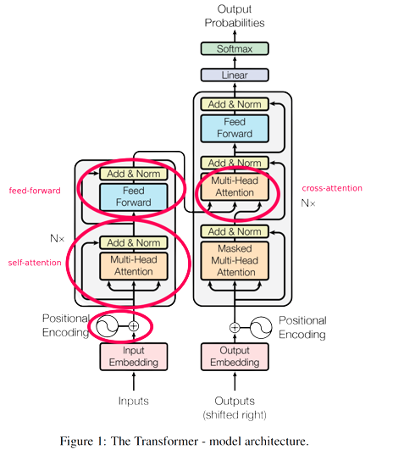
MULTI-HEAD ATTENTION
Multi-Head Self-Attention is a key component of the Transformer architecture that allows the model to capture long-range relationships between words in a sequence. This attention technique is 'multi-headed' because it is applied in parallel by multiple heads within the Encoder or Decoder layer.
Each head learns several attention representations from the input sequence, and their outputs are concatenated and combined to produce a final representation.

Slide 20
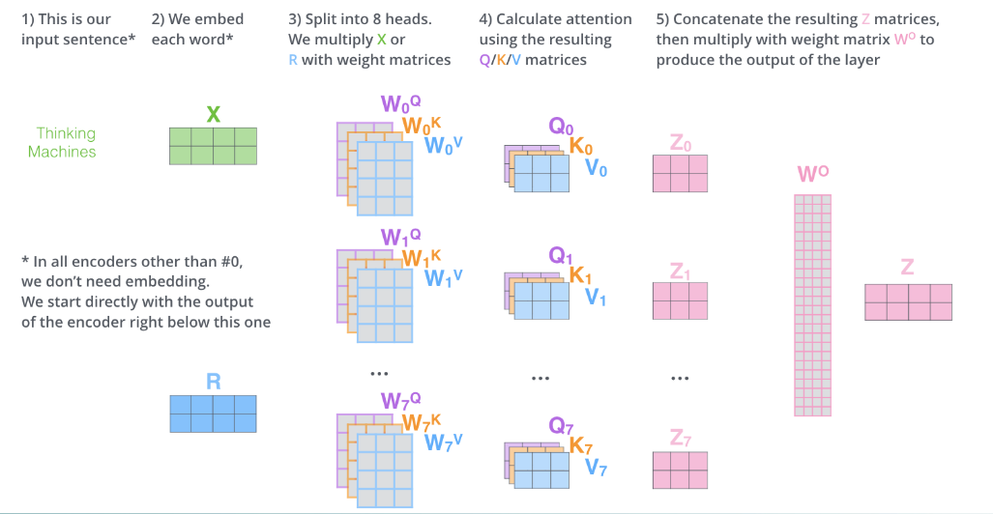
MULTI-HEAD ATTENTION

Slide 21
MULTI-HEAD ATTENTION: CODE
# Definizione dello strato di Self-Attention
class SelfAttention(Layer):
def __init__(self, num_heads, head_dim, **kwargs):
super(SelfAttention, self).__init__(**kwargs)
self.num_heads = num_heads
self.head_dim = head_dim
def build(self, input_shape):
self.W_q = self.add_weight("W_q", shape=(input_shape[-1], self.num_heads * self.head_dim))
self.W_k = self.add_weight("W_k", shape=(input_shape[-1], self.num_heads * self.head_dim))
self.W_v = self.add_weight("W_v", shape=(input_shape[-1], self.num_heads * self.head_dim))
def call(self, inputs):
q = tf.matmul(inputs, self.W_q)
k = tf.matmul(inputs, self.W_k)
v = tf.matmul(inputs, self.W_v)
q = tf.reshape(q, (-1, tf.shape(q)[1], self.num_heads,
self.head_dim))
k = tf.reshape(k, (-1, tf.shape(k)[1], self.num_heads,
self.head_dim))
v = tf.reshape(v, (-1, tf.shape(v)[1], self.num_heads,
self.head_dim))
attention_scores = tf.matmul(q, k, transpose_b=True)
attention_scores = tf.nn.softmax(attention_scores, axis=-1)
output = tf.matmul(attention_scores, v)
output = tf.reshape(output, (-1, tf.shape(output)[1],
self.num_heads * self.head_dim))
return output

Slide 22
BI-LSTM MODEL: CODE
num_features = 5 # Numero di features nel dataset
bi_lstm_attention_model = Sequential()
bi_lstm_attention_model.add(Input(shape=(None, 5)))
bi_lstm_attention_model.add(Activation('relu'))
bi_lstm_attention_model.add(Bidirectional(LSTM(512, return_sequences=True)))
bi_lstm_attention_model.add(Dropout(0.2))
bi_lstm_attention_model.add(Activation('relu'))
bi_lstm_attention_model.add(Bidirectional(LSTM(256, return_sequences=True)))
bi_lstm_attention_model.add(Dropout(0.2))
bi_lstm_attention_model.add(SelfAttention(num_heads=8, heads_dim=64))
bi_lstm_attention_model.add(Dense(512, activation='relu'))
bi_lstm_attention_model.add(Dense(256, activation='relu'))
bi_lstm_attention_model.add(Dense(128, activation='relu'))
bi_lstm_attention_model.add(Dense(64, activation='relu', kernel_regularizer=l2(0.005)))
bi_lstm_attention_model.add(Dense(32, activation='relu', kernel_regularizer=l2(0.005)))
bi_lstm_attention_model.add(Dense(5))
# Compilazione del modello
bi_lstm_attention_model.compile(loss='mse’,
optimizer=Adam(learning_rate=0.000015), metrics=['mean_absolute_error'])

Slide 23
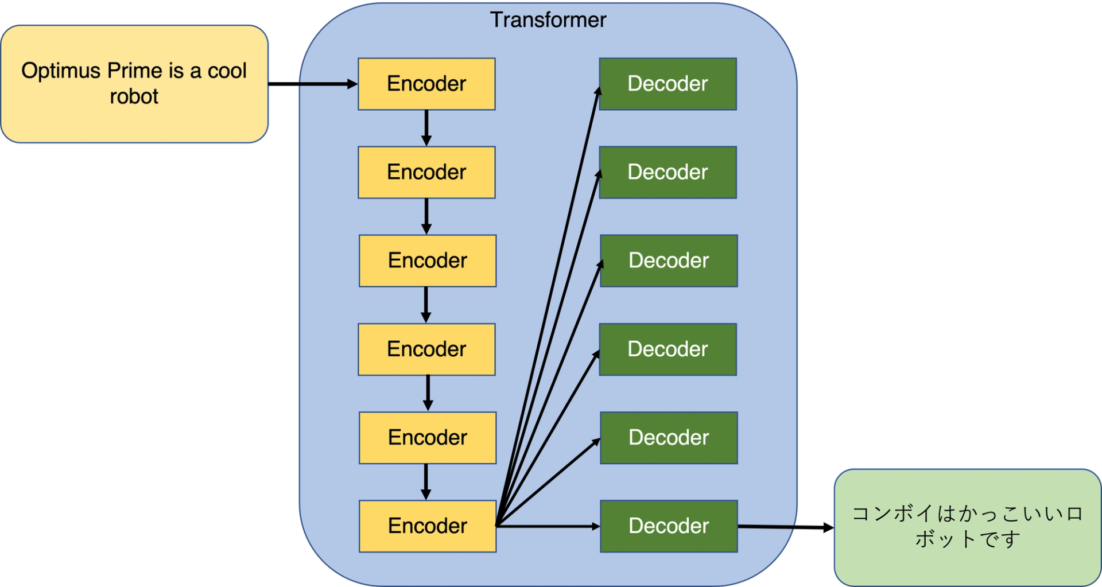
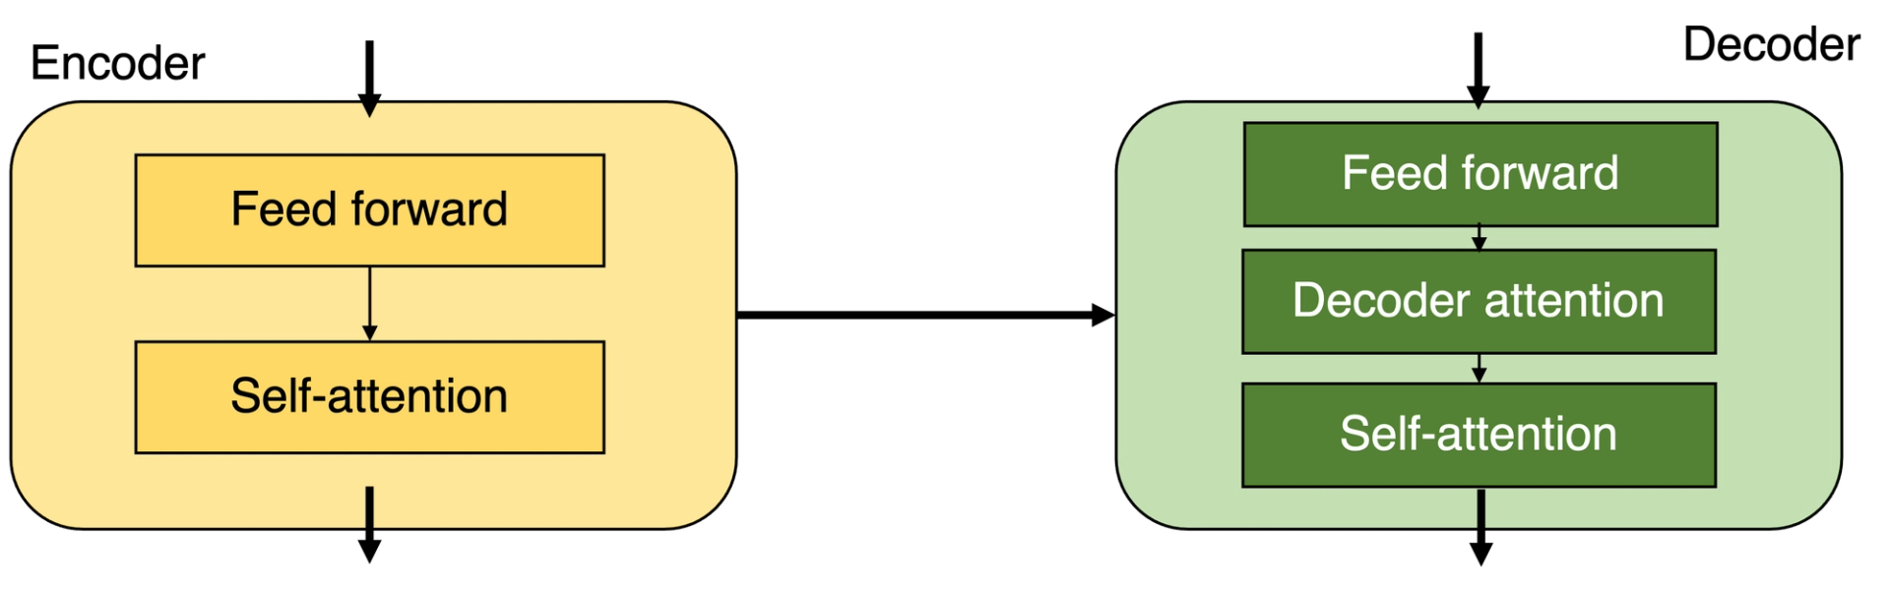
CLASSIC TRANSFORMER
Transformers are another Neural Network architecture and are able to capture long-range content by learning dependencies in the Data between distant positions in the Input and Output sequences.
In the classical architecture we have 2 fundamental components:
Encoding component, i.e. a stack of Encoders, all consisting of: a Self Attention Layer and a Feed Forward Neural Network and do not share weights.
Decoding component, that is, a stack of Decoders, which use the encoded information of the input sequence to generate the desired output, making use of the attention both between the words of the partial output and between the output of the Encoder and the partial output.

Slide 24
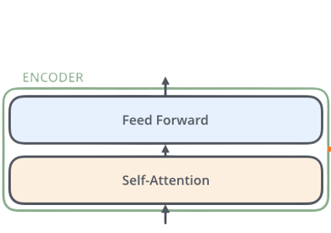
SIMPLIFY TRANSFORMER
The second model analyzed in this report is a simplified Transformer with only the Encoder part and no Decoder part.
This means that the model is primarily designed to encode and process input, but is not designed to generate textual output based on this encoding. This decision was made because the main objective is the prediction of time series based on numerical data, where there is no need to generate sequences of text or other sequential output.
The encoder can be used to extract meaningful patterns and features from historical data, which can then be used to make predictions.

Slide 25

TRANSFORMER MODEL: CODE
# Creazione del modello Sequential
transformer_model = Sequential()
# Aggiunta degli strati al modello
input_layer = Input(shape=(None, num_features)) # Adatta la forma all'intero dataset
# Primo encoder
encoder_1 = SelfAttention(num_heads=num_heads, head_dim=head_dim)(input_layer)
encoder_1 = Dense(128, activation='relu')(encoder_1)
encoder_1 = Dense(128, activation='relu')(encoder_1)
# Secondo encoder
encoder_2 = SelfAttention(num_heads=num_heads, head_dim=head_dim)(encoder_1)
encoder_2 = Dense(64, activation='relu')(encoder_2)
encoder_2 = Dense(64, activation='relu')(encoder_2)
# Concatena l'output dei due encoder
concatenated_output = Concatenate()([encoder_1, encoder_2])
# Output layer
output_layer = Dense(num_features)(concatenated_output)
# Aggiungi l'output layer al modello
transformer_model = tf.keras.Model(inputs=input_layer, outputs=output_layer)

Slide 26
HYBRID MODEL : MIXTURE
he hybrid mixture model is a machine learning model that combines two popular deep learning models for time series prediction: the Bi-LSTM and Transformer models and works as follows:
- Time series data are first fed to the Bi-LSTM and Transformer models that learn the temporal dependencies in the data and produce a prediction for the future value of the time series.
- The predictions of the bi-LSTM model and the transformer model are then combined using a weighted average via the Average() function. The hybrid model is then trained to minimise the mean square error between its predictions and the actual data.
- Once trained, the hybrid model is evaluated using several evaluation metrics, including RMSE, R2 and MAE.
These metrics provide a clear indication of its performance in forecasting share prices.
- Finally, the results are visualised through graphs that show the comparison between the hybrid model's forecasts and the actual data for each of the five financial features. This allows a visual analysis of the model's performance.

Slide 27
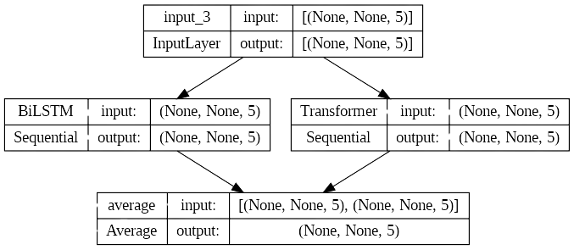
HYBRID MODEL : MIXTURE

Slide 28
HYBRID MODEL: with WEIGHTED ATTENTION
The hybrid model with weighted attention represents an advanced implementation to address the challenge of forecasting financial time series, combining the approaches of Bi-LSTM and Simplified Transformer with Multi-headed attention.
First, the inputs are defined and passed to two distinct branches of the model:
- The first branch involves the Bi-LSTM model with Multi-attention.
- The second branch involves the Simplified Transformer, which also uses the multi-headed attention architecture described above.
After obtaining the outputs from the two branches, we proceed to calculate the attention weights to weight the outputs of the 2 branches.
Then the first branch is multiplied by the attention weights obtained, while the second branch is multiplied by the opposite of the attention weights. This allows the model to assign more importance to one of the two branches based on its relevance and accuracy for a given time sequence.
Subsequently, the weighted outputs of the two branches are combined together through the sum operation.
To further improve the model's ability to capture complex relationships in the data, several dense layers with various units but all with the same ReLU activation function are added. These additional layers help the model to perform further processing and adaptation of the combined outputs.

Slide 29
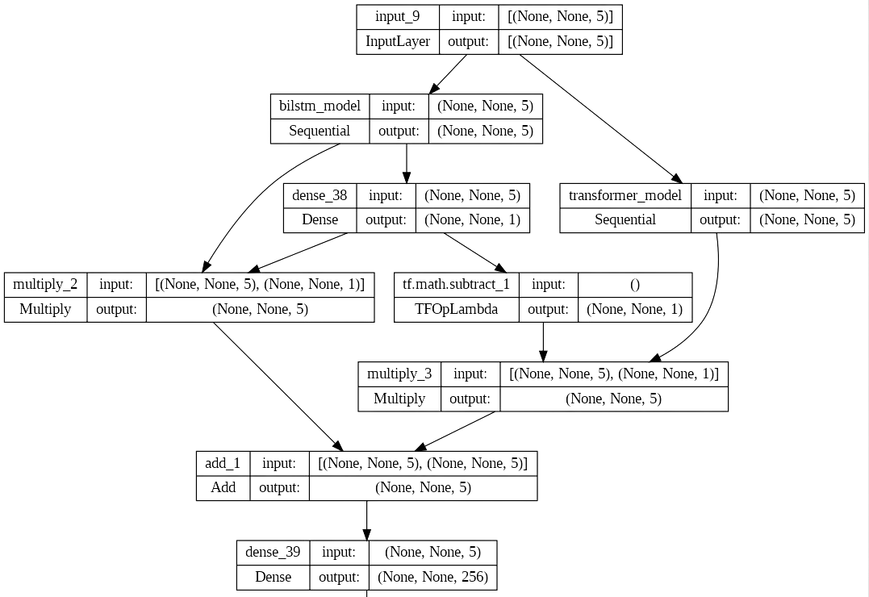
HYBRID MODEL: with WEIGHTED ATTENTION

Slide 30


04
METRICS & RESULTS

Slide 31





METRICS
LOSS: MSE
MAE
is a measure of the discrepancy between model predictions and actual values
measures the mean absolute error between model predictions and actual values in the test data.
RMSE
R-SQUARED
It is the square root of the mean of the squares of the differences between the predictions and the actual values in the test data.
measures how well the model fits the data compared to a model based on the mean.
LEARNING CURVES
GRAPHS & TABLES
are graphs showing how training and validation metrics vary as the number of training epochs increases.
Graphs and financial datasets showing us the difference between predicted and actual data.

Slide 32
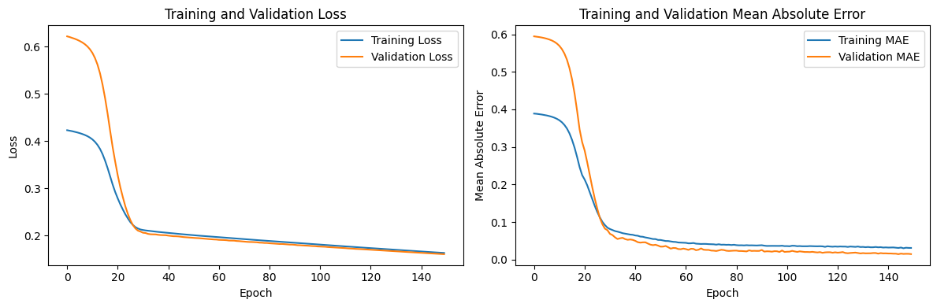
MODEL BI-LSTM: RESULTS
We see the results of the BI-LSTM model on the Apple Dataset:
Training was done with 150 epochs, a batch-size of 64 and learning_rate=0.000015 with a 30% reduction callback.
Loss MSE : 0.09
Mean Absolute Error (MAE): 0.0138
Root Mean Squared Error (RMSE): 0.0198
R-squared (R²): 0.9091
Learning Curves:
Best Validation Loss: 0.0912 at epoch 150
Best Training Loss: 0.914 at epoch 150

Slide 33
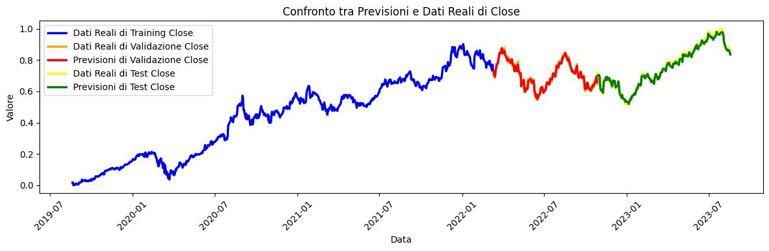
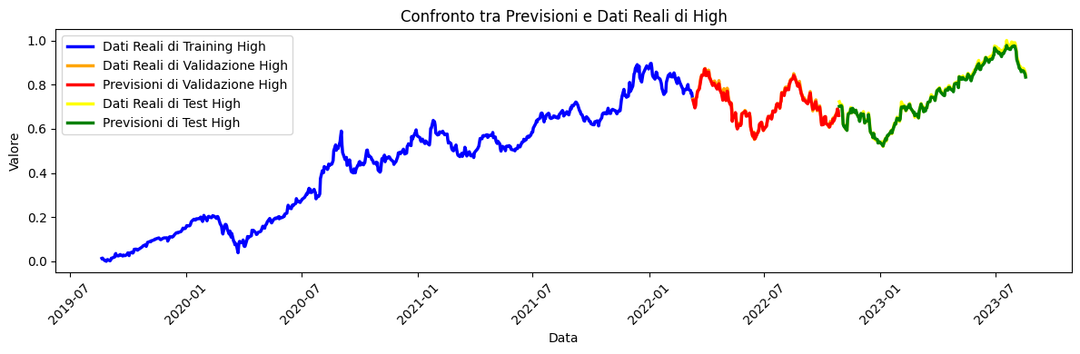

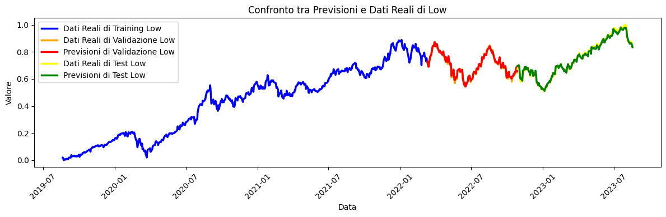
MODEL BI-LSTM: GRAPHIC RESULTS

Slide 34
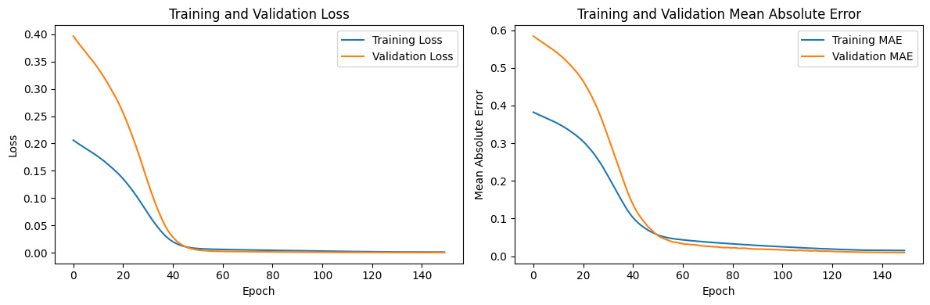
MODEL TRANSFORMER: RESULTS
We see the results of the TRANSFORMER model on the Apple Dataset:
Training was done with 150 epochs, a batch-size of 64 and learning_rate=0.000015 with a 30% reduction callback.
Loss MSE : 0.00018
Mean Absolute Error (MAE): 0.017
Root Mean Squared Error (RMSE): 0.025
R-squared (R²): 0.90
Learning Curves:
Best Validation Loss: 0.0002 at epoch 150
Best Training Loss: 0.001 at epoch 150

Slide 35

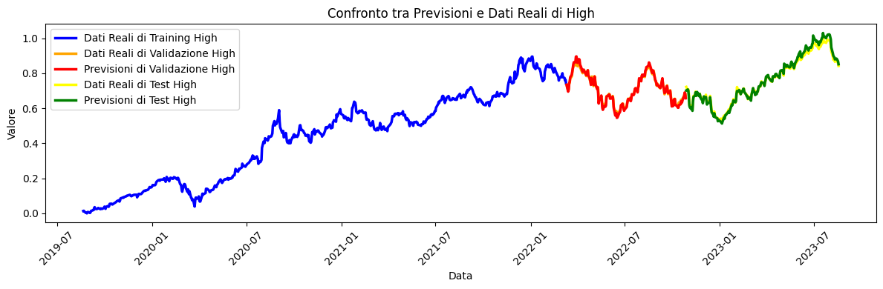
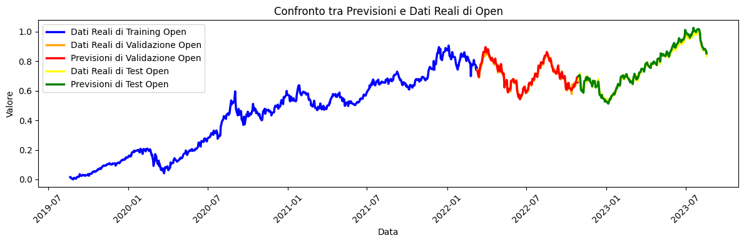

MODEL TRANSFORMER: GRAPHIC RESULTS

Slide 36

HYBRID MIXTURE MODEL : RESULTS
We see the results of the HYBRID MIXTURE model on the Apple Dataset:
The training was not done this time on the hybrid model, as it is a model that averages the training of the 2 previous models: BiLSTM and Simplify Transformer.
Mean Absolute Error (MAE): 0.00987
Root Mean Squared Error (RMSE): 0.0144
R-squared (R²): 0.911
When combining predictions from different models, it is important to ensure that the base models have good individual performance, as the quality of the predictions of the base models will affect the performance of the hybrid model.

Slide 37
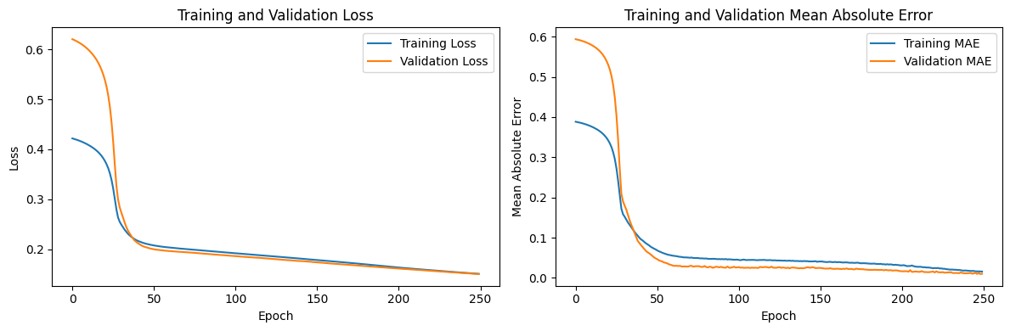
HYBRID MODEL 2: RESULTS
We see the results of the HYBRID MODEL: with WEIGHTED ATTENTION on the Apple Dataset:
Training was done with 150 epochs, a batch-size of 64 and learning_rate=0.000015 with a 30% reduction callback.
Loss MSE : 0.10
Mean Absolute Error (MAE): 0.012
Root Mean Squared Error (RMSE): 0.016
R-squared (R²): 0.90
Learning Curves:
Best Validation Loss: 0.15 at epoch 150
Best Training Loss: 0.1511 at epoch 150

Slide 38




HYBRID MODEL 2: GRAPHIC RESULTS

Slide 39


THANKS FOR WATCHING!

